Slide 1
ECE 551 Digital Design And Synthesis
Fall `19
UVM & Object Oriented Test Benches

Slide 2
Administrative Matters
Project Demos (all team members should be present)
Weds May 1st 1:00PM till evening B555
Thurs May 2nd 1:00PM till evening B555
Fri May 3rd 1:00PM till evening B555
Final Monday May 6th at 2:45PM Soils Bldg room 270
Comprehensive with focus on Lecture 6 – 12
Can have a 8.5x11 cheatsheet
Prior exam will be posted.

Slide 3
UVM
What is UVM ?
Universal Verification Methodology
Object Oriented approach for reusability
Created for the need to automate verification
As an example - UVM allows dynamically configurable test-bench
Allows compiling test-bench once and run with different arguments, stimulus to cover all scenarios
Big Designs - 1000 tests * 5 min compile time per test = That’s 5000 min saved !!

Slide 4
UVM : We can only scratch the surface
Universal Verification Methodology(UVM) based on:
System Verilog Object-Oriented Programming
Dynamically generated objects to specify TB
Transaction level - communication between objects
Stimulus – UVM sequences
We only have enough time to introduce some OOP portions of system Verilog in relation to UVM.

Slide 5
SV: Object Oriented Programming
Enables OOP through class data type
Code Re-use
Implement functionality in TB, re-use it to create more complex functionality without knowing internal details - Encapsulation
Code maintainability
Write common code in one place, access it anywhere from your test-bench

Slide 6
SV Classes
A class is a type
Contains data referred to as class properties
Contains subroutines (task/functions) referred to as class methods
typedef enum reg[1:0] {IDLE,RUN, ...} cmd_t;
class Packet;
cmd_t Command;
int Status;
logic [31:0] Data [0:255];
function int GetStatus();
return(Status);
endfunction : GetStatus
task SetCommand (input cmd_t a);
Command = a;
endtask : SetCommand
endclass : Packet

Slide 7
SV Classes
Classes are dynamically created objects (class instance)
Every class has a method new() call the constructor
It can be explicitly specified or built-in
It can take input aruguments or not
typedef enum reg[1:0] {IDLE,RUN, ...} cmd_t;
class Packet;
cmd_t Command;
int Status;
logic [31:0] Data [0:255];
function int GetStatus();
return(Status);
endfunction : GetStatus
task SetCommand (input cmd_t a);
Command = a;
endtask : SetCommand
endclass : Packet
Packet myPkt = new;
Invoking constructor new creates an instance of class Packet called myPkt
myPkt:
Command:
Status:
Data:
2’bxx
0
32’hx
32’hx
Class Packet has no explicit method new()
32’hx

Slide 8
SV Classes (more constructor examples)
typedef enum reg[1:0] {IDLE,RUN, ...} cmd_t;
class Packet;
cmd_t Command;
int Status;
logic [31:0] Data [0:255];
function new();
Command = IDLE;
endfunction
function int GetStatus();
return(Status);
endfunction : GetStatus
task SetCommand (input cmd_t a);
Command = a;
endtask : SetCommand
endclass : Packet
Packet myPkt = new;
Invoking constructor new creates an instance of class Packet called myPkt
myPkt:
Command:
Status:
Data:
IDLE
0
32’hx
32’hx
32’hx
In this example the class contains an explicit constructor function new that initializes the member Command to IDLE.

Slide 9
SV Classes (more constructor examples)
typedef enum reg[1:0] {IDLE,RUN, ...} cmd_t;
class Packet;
cmd_t Command;
int Status;
logic [31:0] Data [0:255];
function new(input int a);
Command = IDLE;
Status = a;
endfunction
function int GetStatus();
return(Status);
endfunction : GetStatus
task SetCommand (input cmd_t a);
Command = a;
endtask : SetCommand
endclass : Packet
Packet myPkt = new(5);
Invoking the constructor with an input argument.
myPkt:
Command:
Status:
Data:
IDLE
5
32’hx
32’hx
32’hx
In this example the constructor function takes an input argument that allows flexibility in the initialization of the instance created.

Slide 10
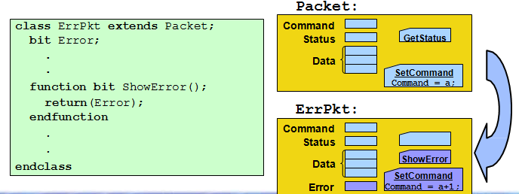
Inheritance
Classes can inherit properties and methods from other classes:
Derived class
Allows customization in derived class without modifying known good functionality of parent class
ErrPkt is derived class of Packet with addition of Error bit
10

Slide 11
Design Example : ALU
op[2:0]
Multi-function ALU that can perform different operations. Some over multiple clock cycles.
A[7:0]
result[15:0]
start
done
B[7:0]
Clk
Rst_n

Slide 12
Design Example : ALU
Opcode description for ALU –
For this design let’s create Object Oriented based test-bench
Operation | Opcode
No_op | 3’b000
Add_op | 3’b001
And_op | 3’b010
Xor_op | 3’b011
Mul_op | 3’b100
Unused | 3’b101 – 3’b111

Slide 13
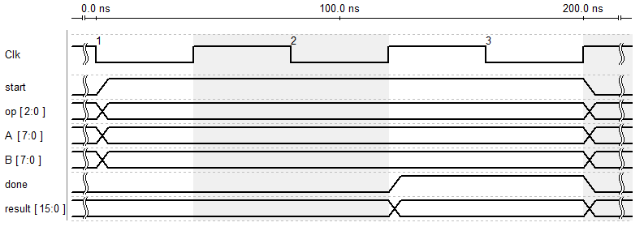
Design Example : ALU
Waveform for ALU –
Start must remain high and operator , operands remain stable until ALU raises done signal and result is available

Slide 14
Object Oriented TB for ALU
Testbench contains one module and four classes –
Top Level Module
Instantiate testbench class
Tester Class
Testbench Class
Top level class instantiates 3 classes
Scoreboard Class
Coverage Class

Slide 15
System Verilog: Interface (allows one to encapsulate an interface)
System Verilog interface encapsulate port signals in a test-bench – First step in modular test-bench
This makes it easy to share signals between modules/objects
interface tiny_alu_bfm;
bit [7:0] A;
bit [7:0] B;
bit clk;
bit reset_n
bit [2:0] op
bit start
wire done
wire [15:0] result;
.
.
.
endinterface
Interface to ALU is defined and can be reused.
Interface is named: tiny_alu_bfm
bfm = Bus Functional Model
BFM is a term you will hear a lot and typically refers to an interface and a set of tasks associated with that interface that allow you to drive stimulus and check response.

Slide 16
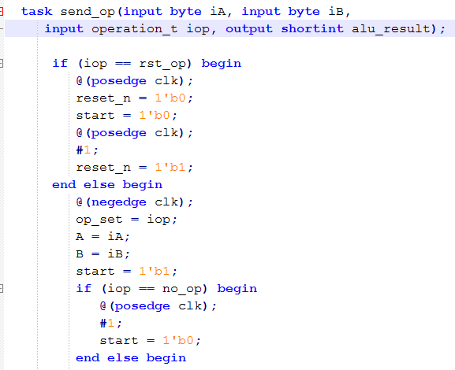
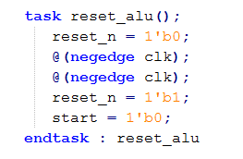
BFM : interface & tasks/functions for stimulus/response
interface tiny_alu_bfm;
bit [7:0] A;
.
.
.
wire done
wire [15:0] result;
BFM tasks called inside TB classes to drive/monitor
.
.
.
endinterface;

Slide 17
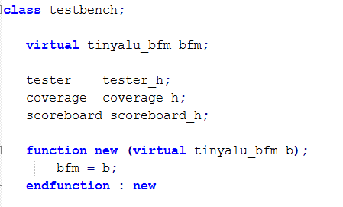
Testbench class
Object’s world equivalent of module’s port list. Object access signal by getting a handle to system verilog interface defined previously
Getting the handle to the interface into the bfm variable. Handle would be passed by top level module which instantiates testbench class

Slide 18
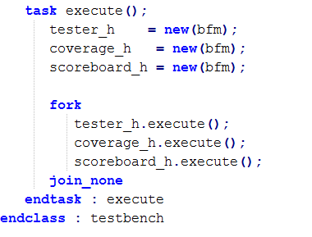
Testbench class : continued
Execute task instantiates the lower level class objects passing bfm interface handle and also launches their execute method
This is same as instantiating three modules, each with its own initial or always block

Slide 19
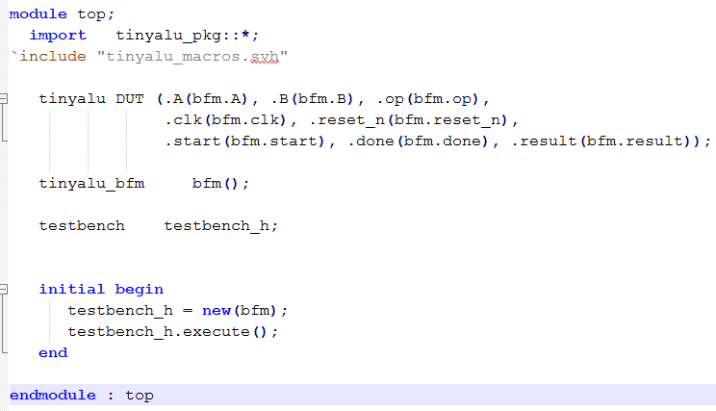
Top Level Module
Tinyalu_pkg defines the four classes
DUT and BFM are instantiated
Variable ‘testbench_h’ -- an object of test-bench class is declared
BFM handle is passed to test-bench object
TB object can use task in BFM to drive, monitor signals
Execute task method in testbench class is called

Slide 20
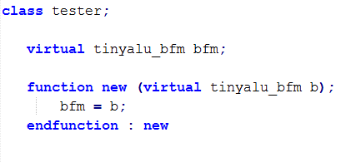
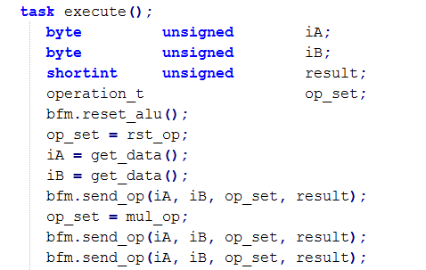
Tester class (drives the stimulus)
Execute task generates random transaction and drive them using BFM interface send_op defined earlier
Get_data() is just a task that assigns a random byte for input stimulus. Defined elsewhere (in code we didn’t look at)
Tester class is not bothered about protocol level details of sending command !!
Taken care by one piece of code i.e. bfm interface

Slide 21
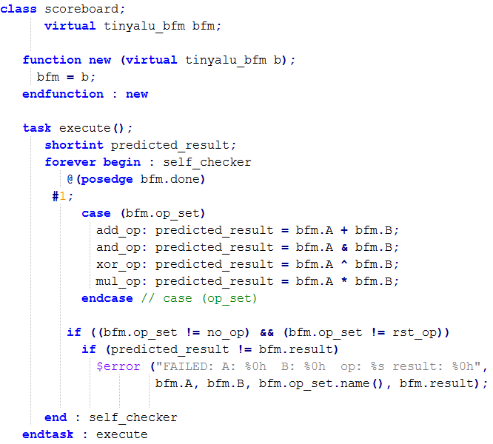
Scoreboard class (The self checking part)
Scoreboard class checks that DUT is working. Usual declarations as before
Waits on posedge of done and checks the predicted output by monitoring signals via BFM interface

Slide 22
Putting it together
Coverage class would perform code coverage metrics. Not covered here.
We created simple test-bench using objects instead of modules
Top level module declares object, instantiate and launch them all in their own thread.
Now, this test-bench has the flexibility and re-use power of OOP
UVM is a complex topic worthy of its course. It has become widely used in industry.

Slide 23
References
UVM primer Book by Ray Salemi
Course - http://www.cerc.utexas.edu/~jaa/ee382m-verif/
Slides created from content of Kushagra Garg

